Slide 1
Assignment

Slide 2
numerical methods topics, each with a relevant real-life dataset source (mostly from Kaggle, UCI ML Repository, or scikit-learn datasets).
Each assignment applies a numerical method in an ML-relevant way (e.g., optimization, regression, root-finding).

Slide 3
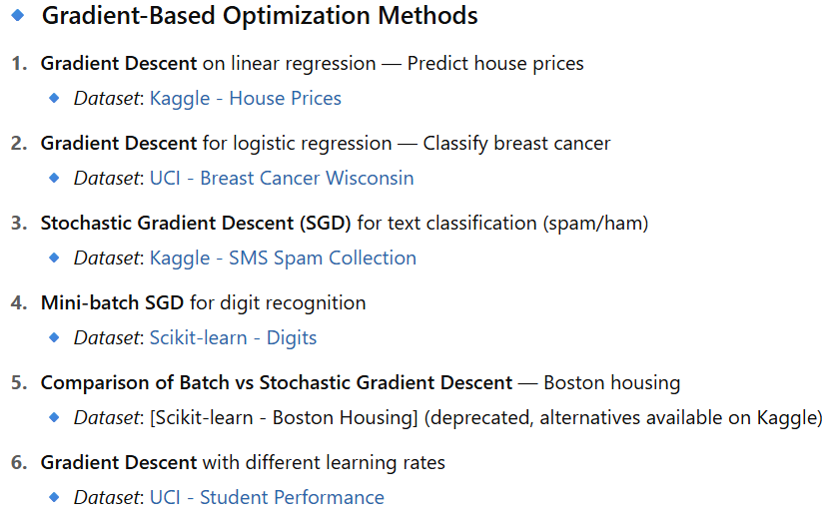

Slide 4
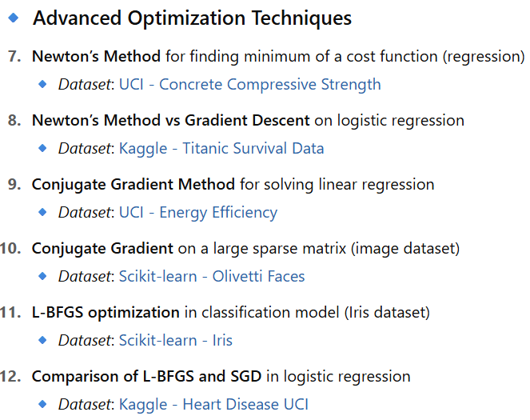

Slide 5
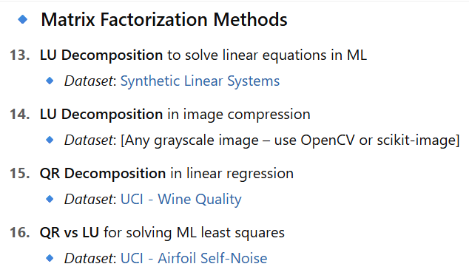

Slide 6
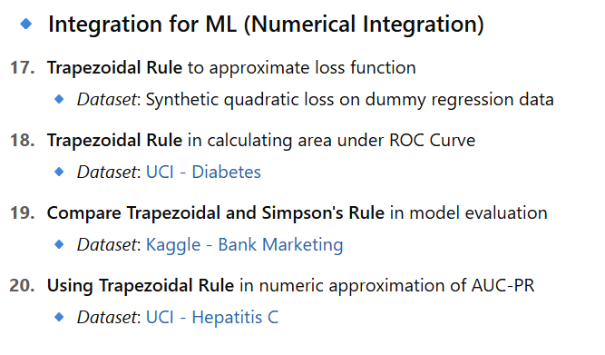

Slide 7
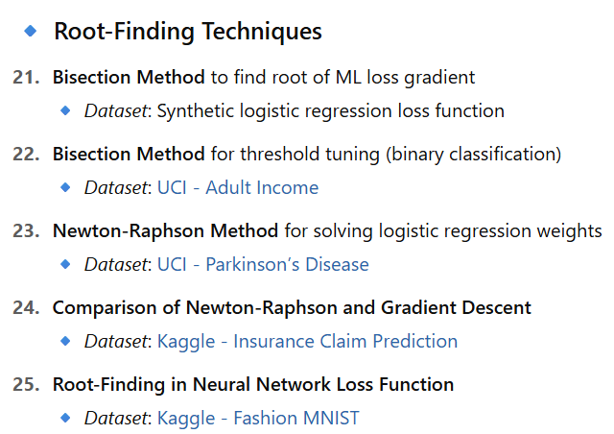

Slide 8
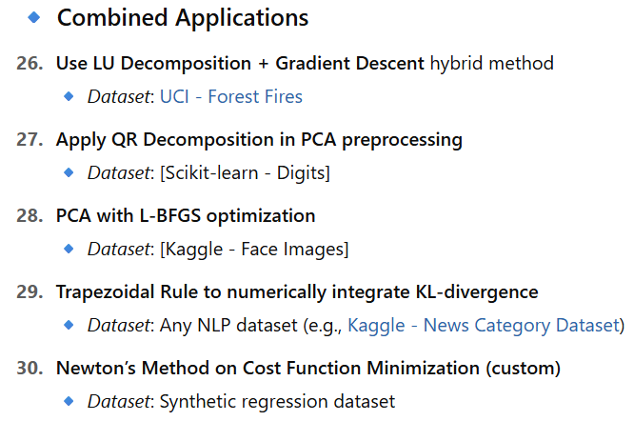

Slide 9
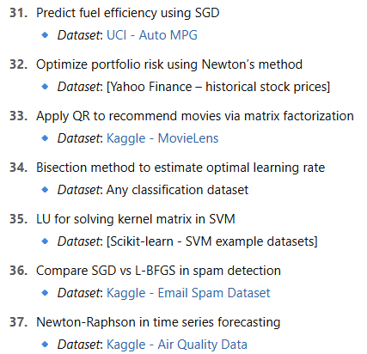
Student-Level Mini Projects

Slide 10
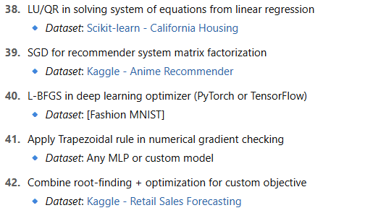
Student-Level Mini Projects

